Slide 1
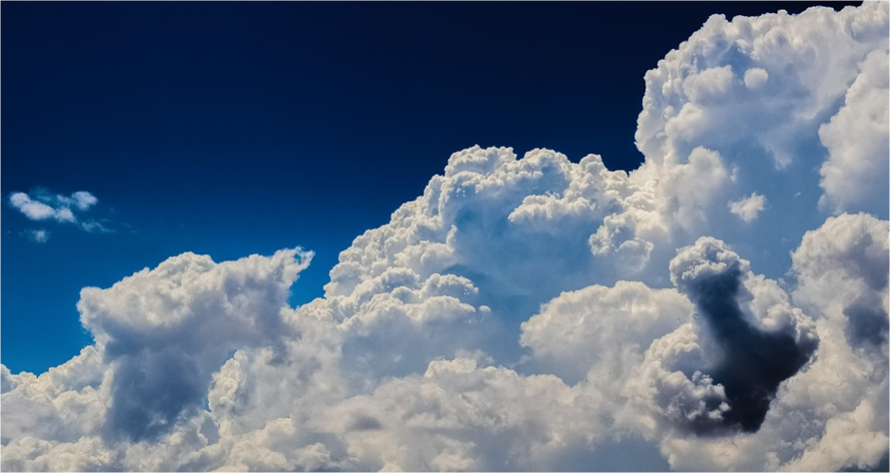
The Water Cycle
More free PPTs on: www.ecosystemforkids.com

Slide 2
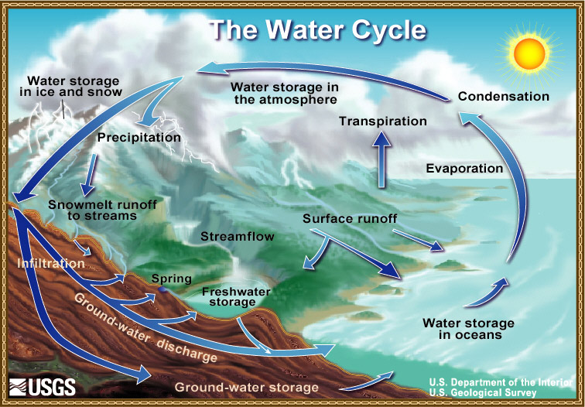
The Water Cycle Diagram
More free PPTs on: www.ecosystemforkids.com

Slide 3
What Is The Water Cycle ?
The water cycle is also known as the hydrological cycle or hydrologic cycle.
It is constant movement of water on, above and below the surface of the Earth.
The water cycle describes how water evaporates from the surface of the earth, rises into the atmosphere, cools and condenses into rain or snow in clouds, and falls again to the surface as precipitation (https://pmm.nasa.gov)
More free PPTs on: www.ecosystemforkids.com

Slide 4
Stages Of The Water Cycle
Evaporation is the process whereby water becomes water vapor. The water is mainly from bodies like rivers, lakes, oceans, wet surfaces after rain etc. When the water gets heated up by the sun it tends to evaporate into the atmosphere.
Condensation is the process whereby water that rose into the atmosphere as vapor cools down. At high altitudes temperatures are low so water cools down to form water droplets and ice particles. These combine to form clouds.
Evaporation.
Condensation.
Sublimation
Precipitation
Transpiration
Infiltration
Runoff
Sublimation is the process whereby ice sheets transform directly into water vapor. This happens especially in polar areas which have large expanses of ice cover.
Precipitation is the process whereby condensed clouds fall to the Earth’s surface as rain, drizzle, sleet, snow or hail.
Transpiration is the process whereby plant leaves release water through the stomata into the atmosphere during photosynthesis. It is similar to evaporation, the difference being that it originates from plants.
Infiltration occurs when water that falls back on the Earth’s surface through precipitation seeps deep into the soil. This process increases the ground water table.
Runoff is the water that runs off after rainfall or when snow melts into channels that flow into rivers, lakes, oceans and other water reservoirs.
More free PPTs on: www.ecosystemforkids.com

Slide 5
The Sun And The Water Cycle
The sun is what makes the water cycle work. The sun provides what almost everything on Earth needs to go—energy, or heat. Heat causes liquid and frozen water to evaporate into water vapor gas, which rises high in the sky to form clouds...clouds that move over the globe and drop rain and snow. This process is a large part of the water cycle (https://water.usgs.gov).
More free PPTs on: www.ecosystemforkids.com

Slide 6
The Water Cycle Diagram
Sun is the driving force behind the process. It heats the Earth’s surface and water bodies; this leads to evaporation. The sun is also the driver of the process of photosynthesis that also releases water through transpiration
Condensation is the process whereby water that rose into the atmosphere as vapor cools down. At high altitudes temperatures are low so water cools down to form water droplets and ice particles. These combine to form clouds.
Transpiration is the process whereby plant leaves release water through the stomata into the atmosphere during photosynthesis. It is similar to evaporation, the difference being that it originates from plants.
Precipitation is the process whereby condensed clouds fall to the Earth’s surface as rain, drizzle, sleet, snow or hail.
Evaporation is the process whereby water becomes water vapor. The water is mainly from bodies like rivers, lakes, oceans, wet surfaces after rain etc. When the water gets heated up by the sun it tends to evaporate into the atmosphere.
Infiltration occurs when water that falls back on the Earth’s surface through precipitation seeps deep into the soil. This process increases the ground water table.
Runoff is the water that runs off after rainfall or when snow melts into channels that flow into rivers, lakes, oceans and other water reservoirs.
More free PPTs on: www.ecosystemforkids.com

Slide 7
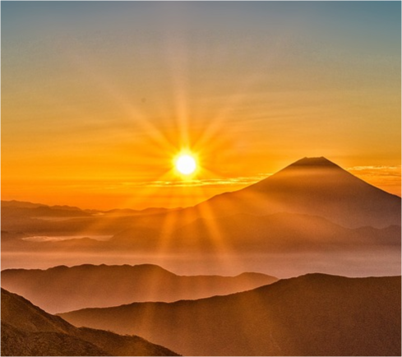
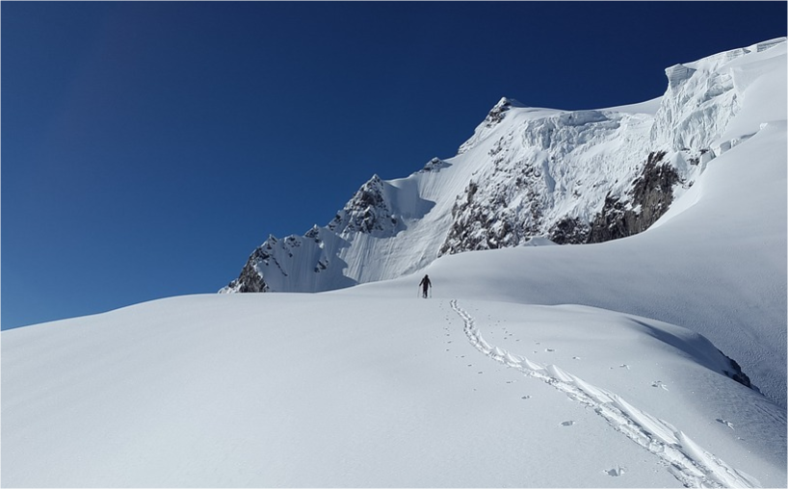
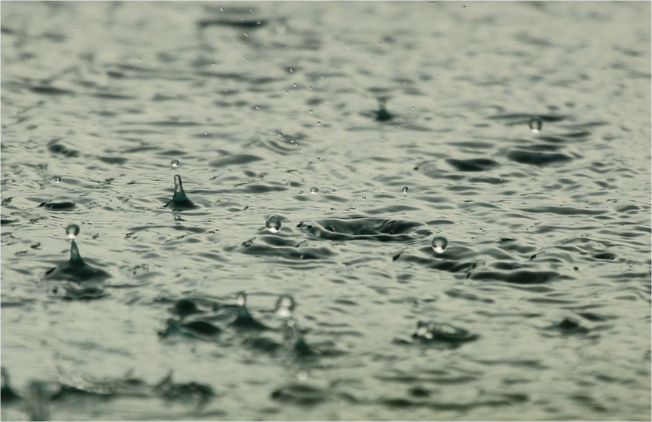
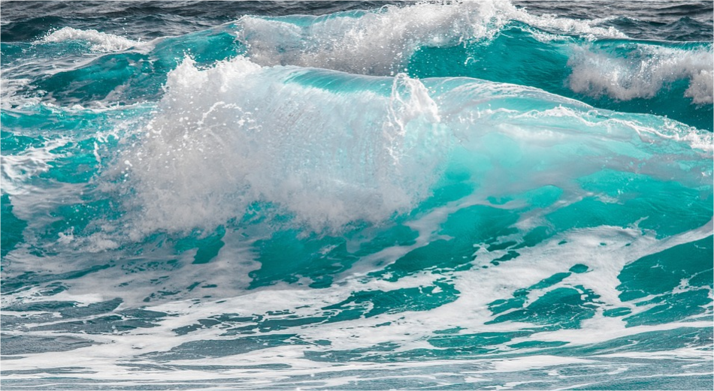
Identify The Following
How do they relate
to the water cycle ?
More free PPTs on: www.ecosystemforkids.com

Slide 8
www.ecosystemforkids.com
Visit the website above for more free science teaching resources for teachers and parents of students in 1st to 6th grades.
Features: Free | PowerPoint Lessons | Worksheets pdf | Online quizzes | Games | Board Games | Card Games | More
More free PPTs on: www.ecosystemforkids.com

